Slide 1

Chapter 3
Exploratory Factor Analysis
Copyright © 2007
Prentice-Hall, Inc.

Slide 2
Chapter 3: Exploratory Factor Analysis
LEARNING OBJECTIVES:
Upon completing this chapter, you should be able to do the following:
Differentiate factor analysis techniques from other multivariate techniques.
Distinguish between exploratory and confirmatory uses of factor analytic techniques.
Understand the seven stages of applying factor analysis.
Distinguish between R and Q factor analysis.
Identify the differences between component analysis and common factor analysis models.
Tell how to determine the number of factors to extract.
Explain the concept of rotation of factors.
Describe how to name a factor.
Explain the additional uses of factor analysis.
State the major limitations of factor analytic techniques.

Slide 3
Factor Analysis Defined
Factor analysis . . . is an interdependence technique whose primary purpose is to define the underlying structure among the variables in the analysis.

Slide 4
What is Factor Analysis?
Factor analysis . . .
Examines the interrelationships among a large number of variables and then attempts to explain them in terms of their common underlying dimensions.
These common underlying dimensions are referred to as factors.
Is a summarization and data reduction technique that does not have independent and dependent variables, but an interdependence technique in which all variables are considered simultaneously.

Slide 5
Factor Analysis Decision Process
Stage 1: Objectives of Factor Analysis
Stage 2: Designing a Factor Analysis
Stage 3: Assumptions in Factor Analysis
Stage 4: Deriving Factors and Assessing Overall Fit
Stage 5: Interpreting the Factors
Stage 6: Validation of Factor Analysis
Stage 7: Additional uses of Factor Analysis Results

Slide 6
Stage 1: Objectives of Factor Analysis
Is the objective exploratory or confirmatory?
Specify the unit of analysis.
Data summarization and/or reduction?
Using Factor analysis with other techniques.

Slide 7
Factor Analysis Outcomes
Data summarization = derives underlying dimensions that, when interpreted and understood, describe the data in a much smaller number of concepts than the original individual variables.
Data reduction = extends the process of data summarization by deriving an empirical value (factor score) for each dimension (factor) and then substituting this value for the original values.

Slide 8
Stage 2: Designing a Factor Analysis
Three Basic Decisions:
Calculation of input data – R vs. Q analysis.
Design of study in terms of number of variables, measurement properties of variables, and the type of variables.
Sample size necessary.

Slide 9
Rules of Thumb 3–1
Factor Analysis Design
Factor analysis is performed most often only on metric variables, although specialized methods exist for the use of dummy variables. A small number of “dummy variables” can be included in a set of metric variables that are factor analyzed.
If a study is being designed to reveal factor structure, strive to have at least five variables for each proposed factor.
For sample size:
  the sample must have more observations than variables.
  the minimum absolute sample size should be 50 observations.
Maximize the number of observations per variable, with a minimum of five and hopefully at least ten observations per variable.

Slide 10
Stage 3: Assumptions in Factor Analysis
Three Basic Decisions:
Calculation of input data – R vs. Q analysis.
Design of study in terms of number of variables, measurement properties of variables, and the type of variables.
Sample size necessary.

Slide 11
Assumptions:
Multicollinearity.
    Assessed using MSA (measure of sampling adequacy).
Homogeneity of sample factor solutions.
The MSA is measured by the Kaiser-Meyer-Olkin (KMO) statistics. As a measure of sampling adequacy, the KMO predicts if data are likely to factor well based on correlation and partial correlation. KMO can be used to identify which variables to drop from the factor analysis because they lack multicollinearity.
There is a KMO statistic for each individual variable, and their sum is the KMO overall statistic. KMO varies from 0 to 1.0. Overall KMO should be .50 or higher to proceed with factor analysis. If it is not, remove the variable with the lowest individual KMO statistic value one at a time until KMO overall rises above .50, and each individual variable KMO is above .50.

Slide 12
Rules of Thumb 3–2
Testing Assumptions of Factor Analysis
There must be a strong conceptual foundation to support the assumption that a structure does exist before the factor analysis is performed.
A statistically significant Bartlett’s test of sphericity (sig. > .05) indicates that sufficient correlations exist among the variables to proceed.
Measure of Sampling Adequacy (MSA) values must exceed .50 for both the overall test and each individual variable. Variables with values less than .50 should be omitted from the factor analysis one at a time, with the smallest one being omitted each time.

Slide 13
Stage 4: Deriving Factors and Assessing Overall Fit
Selecting the factor extraction method – common vs. component analysis.
Determining the number of factors to represent the data.

Slide 14
Extraction Decisions:
Which method?
    Principal Components Analysis.
    Common Factor Analysis.
How to rotate?
    Orthogonal or Oblique rotation.

Slide 15
Extraction Method Determines the
Types of Variance Carried into the Factor Matrix
Diagonal Value Variance
Unity (1)
Communality
Total Variance
Common
Specific and Error
Variance extracted
Variance not used

Slide 16
Principal Components vs. Common?
Two Criteria:
Objectives of the factor analysis.
Amount of prior knowledge about
the variance in the variables.

Slide 17
Number of Factors?
A Priori Criterion.
Latent Root Criterion.
Percentage of Variance.
Scree Test Criterion.

Slide 18
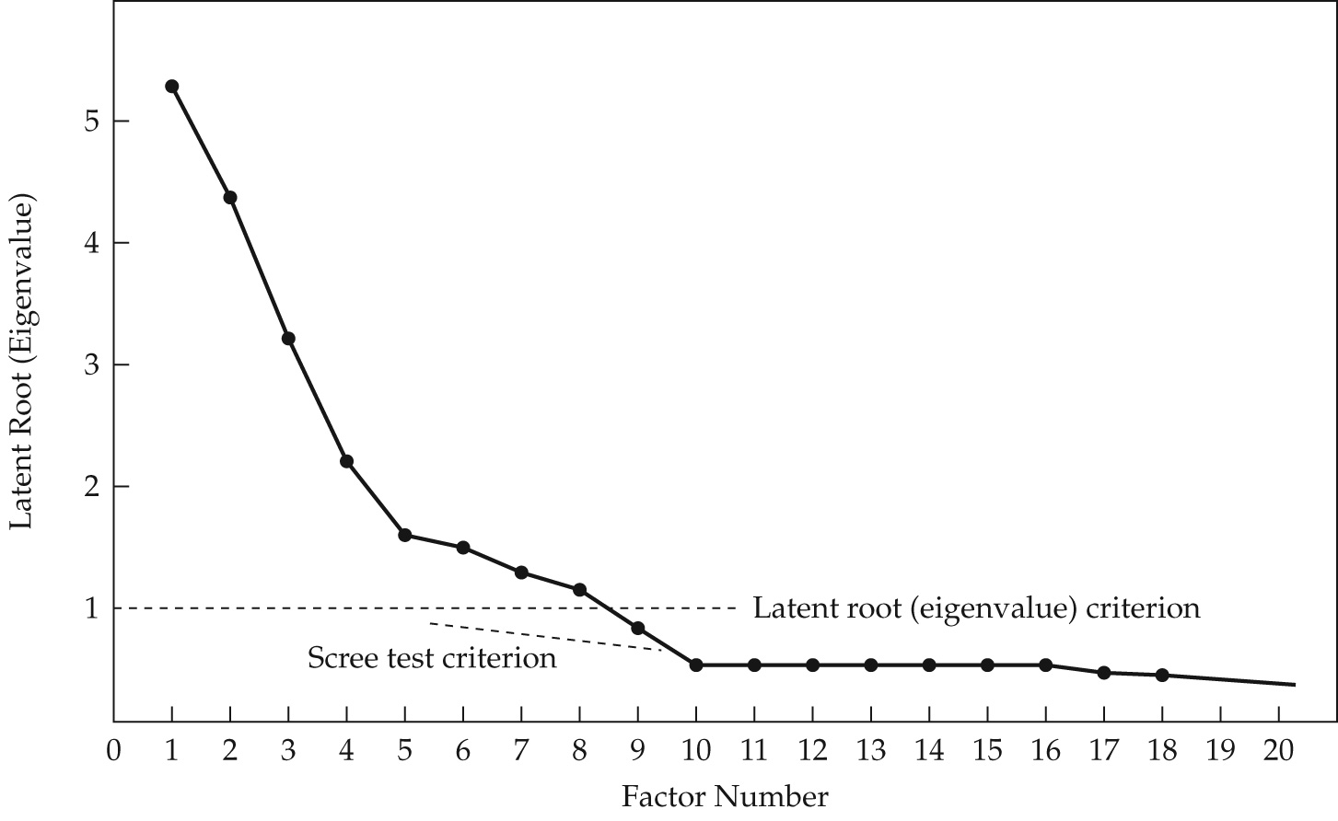
Eigenvalue Plot for Scree Test Criterion

Slide 19
Rules of Thumb 3–3
Choosing Factor Models and Number of Factors
Although both component and common factor analysis models yield similar results in common research settings (30 or more variables or communalities of .60 for most variables):
  the component analysis model is most appropriate when data reduction is paramount.
  the common factor model is best in well-specified theoretical applications.
Any decision on the number of factors to be retained should be based on several considerations:
  use of several stopping criteria to determine the initial number of factors to retain.
  Factors With Eigenvalues greater than 1.0.
  A pre-determined number of factors based on research objectives and/or prior research.
  Enough factors to meet a specified percentage of variance explained, usually 60% or higher.
  Factors shown by the scree test to have substantial amounts of common variance (i.e., factors before inflection point).
  More factors when there is heterogeneity among sample subgroups.
Consideration of several alternative solutions (one more and one less factor than the initial solution) to ensure the best structure is identified.

Slide 20
Processes of Factor Interpretation
Estimate the Factor Matrix.
Factor Rotation.
Factor Interpretation.
Respecification of factor model, if needed, may involve:
  Deletion of variables from analysis.
  Desire to use a different rotational approach.
  Need to extract a different number of factors.
  Desire to change method of extraction.

Slide 21
Rotation of Factors
Factor rotation = the reference axes of the factors are tuned about the origin until some other position has been reached. Since unrotated factor solutions extract factors based on how much variance they account for, with each subsequent factor accounting for less variance, the ultimate effect of rotating the factor matrix is to redistribute the variance from earlier factors to later ones to achieve a simpler, theoretically more meaningful factor pattern.

Slide 22
Two Rotational Approaches:
Orthogonal = axes are maintained at 90 degrees.
Oblique = axes are not maintained at 90 degrees.

Slide 23
Orthogonal Factor Rotation
Unrotated Factor II
+1.0
+.50
Rotated Factor II
V₁
V₂
Unrotated Factor I
-1.0 -.50 0
+.50 +1.0
V₃
V₄
-.50
-1.0
Rotated Factor I
V₅

Slide 24
Oblique Factor Rotation
Unrotated Factor II
Orthogonal Rotation: Factor II
+1.0
+.50
V₁
Oblique Rotation: Factor II
V₂
Unrotated Factor I
-1.0 -.50 0
+.50 +1.0
V₃
V₄
Oblique Rotation: Factor I
-.50
-1.0
V₅
Orthogonal Rotation: Factor I

Slide 25
Orthogonal Rotation Methods:
Quartimax (simplify rows).
Varimax (simplify columns).
Equimax (combination).

Slide 26
Rules of Thumb 3–4
Choosing Factor Rotation Methods
Orthogonal rotation methods:
  are the most widely used rotational methods.
  are The preferred method when the research goal is data reduction to either a smaller number of variables or a set of uncorrelated measures for subsequent use in other multivariate techniques.
Oblique rotation methods:
  best suited to the goal of obtaining several theoretically meaningful factors or constructs because, realistically, very few constructs in the “real world” are uncorrelated.

Slide 27
Which Factor Loadings Are Significant?
Customary Criteria = Practical Significance.
Sample Size & Statistical Significance.
Number of Factors ( = >) and/or Variables ( = <) .

Slide 28
Guidelines for Identifying Significant
Factor Loadings Based on Sample Size
Factor Loading Sample Size Needed for Significance*
.30 350
.35 250
.40 200
.45 150
.50 120
.55 100
.60 85
.65 70
.70 60
.75 50
*Significance is based on a .05 significance level (a), a power level of 80 percent, and standard errors assumed to be twice those of conventional correlation coefficients.

Slide 29
Rules of Thumb 3–5
Assessing Factor Loadings
While factor loadings of +.30 to +.40 are minimally acceptable, values greater than + .50 are considered necessary for practical significance.
To be considered significant:
  A smaller loading is needed given either a larger sample size, or a larger number of variables being analyzed.
  A larger loading is needed given a factor solution with a larger number of factors, especially in evaluating the loadings on later factors.
Statistical tests of significance for factor loadings are generally very conservative and should be considered only as starting points needed for including a variable for further consideration.

Slide 30
Stage 5: Interpreting the Factors
Selecting the factor extraction method – common vs. component analysis.
Determining the number of factors to represent the data.

Slide 31
Interpreting a Factor Matrix:
Examine the factor matrix of loadings.
Identify the highest loading across all factors for each variable.
Assess communalities of the variables.
Label the factors.

Slide 32
Rules of Thumb 3–6
Interpreting The Factors
An optimal structure exists when all variables have high loadings only on a single factor.
Variables that cross-load (load highly on two or more factors) are usually deleted unless theoretically justified or the objective is strictly data reduction.
Variables should generally have communalities of greater than .50 to be retained in the analysis.
Respecification of a factor analysis can include options such as:
  deleting a variable(s),
  changing rotation methods, and/or
  increasing or decreasing the number of factors.

Slide 33
Stage 6: Validation of Factor Analysis
Confirmatory Perspective.
Assessing Factor Structure Stability.
Detecting Influential Observations.

Slide 34
Stage 7: Additional Uses of Factor Analysis Results
Selecting Surrogate Variables.
Creating Summated Scales.
Computing Factor Scores.

Slide 35
Rules of Thumb 3–7
Summated Scales
A summated scale is only as good as the items used to represent the construct. While it may pass all empirical tests, it is useless without theoretical justification.
Never create a summated scale without first assessing its unidimensionality with exploratory or confirmatory factor analysis.
Once a scale is deemed unidimensional, its reliability score, as measured by Cronbach’s alpha:
  should exceed a threshold of .70, although a .60 level can be used in exploratory research.
  the threshold should be raised as the number of items increases, especially as the number of items approaches 10 or more.
With reliability established, validity should be assessed in terms of:
  convergent validity = scale correlates with other like scales.
  discriminant validity = scale is sufficiently different from other related scales.
  nomological validity = scale “predicts” as theoretically suggested.

Slide 36
Rules of Thumb 3–8
Representing Factor Analysis In Other Analyses
The single surrogate variable:
  Advantages: simple to administer and interpret.
  Disadvantages:
    does not represent all “facets” of a factor
    prone to measurement error.
Factor scores:
  Advantages:
    represents all variables loading on the factor,
    best method for complete data reduction.
    Are by default orthogonal and can avoid complications caused by multicollinearity.
  Disadvantages:
    interpretation more difficult since all variables contribute through loadings
    Difficult to replicate across studies.

Slide 37
Rules of Thumb 3–8 Continued . . .
Representing Factor Analysis In Other Analyses
Summated scales:
  Advantages:
    compromise between the surrogate variable and factor score options.
    reduces measurement error.
    represents multiple facets of a concept.
    easily replicated across studies.
  Disadvantages:
    includes only the variables that load highly on the factor and excludes those having little or marginal impact.
    not necessarily orthogonal.
    Require extensive analysis of reliability and validity issues.

Slide 38
Description of HBAT Primary Database Variables
Variable Description Variable Type
Data Warehouse Classification Variables
X1 Customer Type nonmetric
X2 Industry Type nonmetric
X3 Firm Size nonmetric
X4 Region nonmetric
X5 Distribution System nonmetric
Performance Perceptions Variables
X6 Product Quality metric
X7 E-Commerce Activities/Website metric
X8 Technical Support metric
X9 Complaint Resolution metric
X10 Advertising metric
X11 Product Line metric
X12 Salesforce Image metric
X13 Competitive Pricing metric
X14 Warranty & Claims metric
X15 New Products metric
X16 Ordering & Billing metric
X17 Price Flexibility metric
X18 Delivery Speed metric
Outcome/Relationship Measures
X19 Satisfaction metric
X20 Likelihood of Recommendation metric
X21 Likelihood of Future Purchase metric
X22 Current Purchase/Usage Level metric
X23 Consider Strategic Alliance/Partnership in Future nonmetric

Slide 39
Rotated Component Matrix
“Reduced Set” of HBAT Perceptions Variables
Component Communality
1 2 3 4
X9 – Complaint Resolution .933 .890
X18 – Delivery Speed .931 .894
X16 – Order & Billing .886 .806
X12 – Salesforce Image .898 .860
X7 – E-Commerce Activities .868 .780
X10 – Advertising .743 .585
X8 – Technical Support .940 .894
X14 – Warranty & Claims .933 .891
X6 – Product Quality .892 .798
X13 – Competitive Pricing -.730 .661
Sum of Squares 2.589 2.216 1.846 1.406 8.057
Percentage of Trace 25.893 22.161 18.457 14.061 80.572
Extraction Method: Principal Component Analysis.
Rotation Method: Varimax.

Slide 40
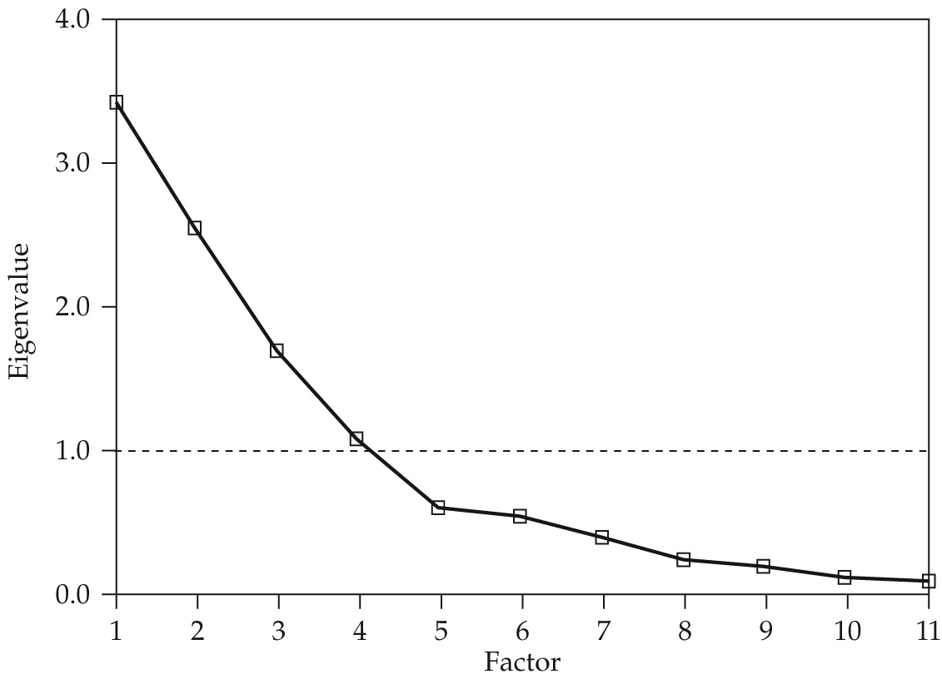
Scree Test for HBAT Component Analysis

Slide 41
Factor Analysis Learning Checkpoint:
What are the major uses of factor analysis?
What is the difference between component analysis and common factor analysis?
Is rotation of factors necessary?
How do you decide how many factors to extract?
What is a significant factor loading?
How and why do you name a factor?
Should you use factor scores or summated ratings in follow-up analyses?

